Slide 1
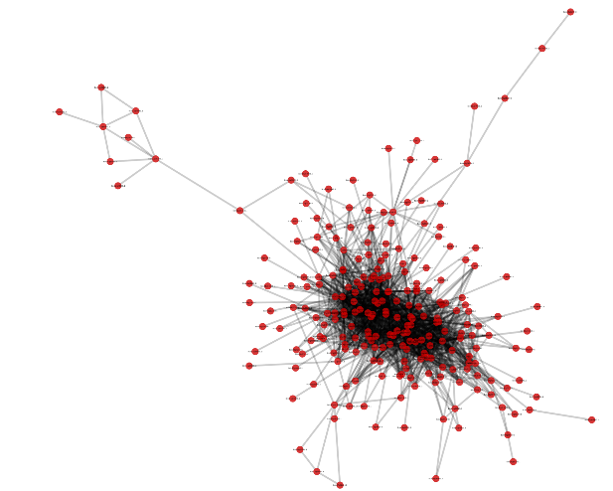
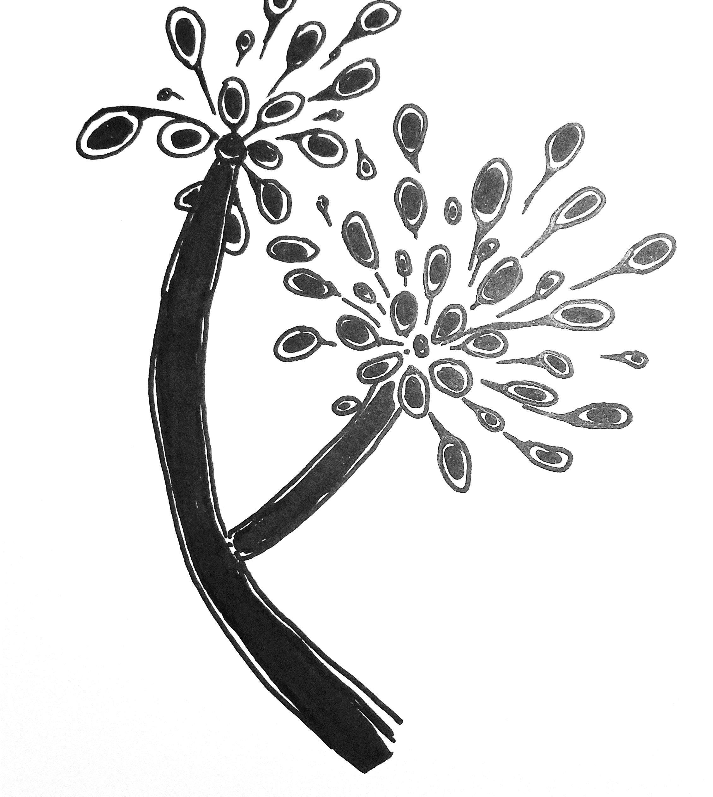
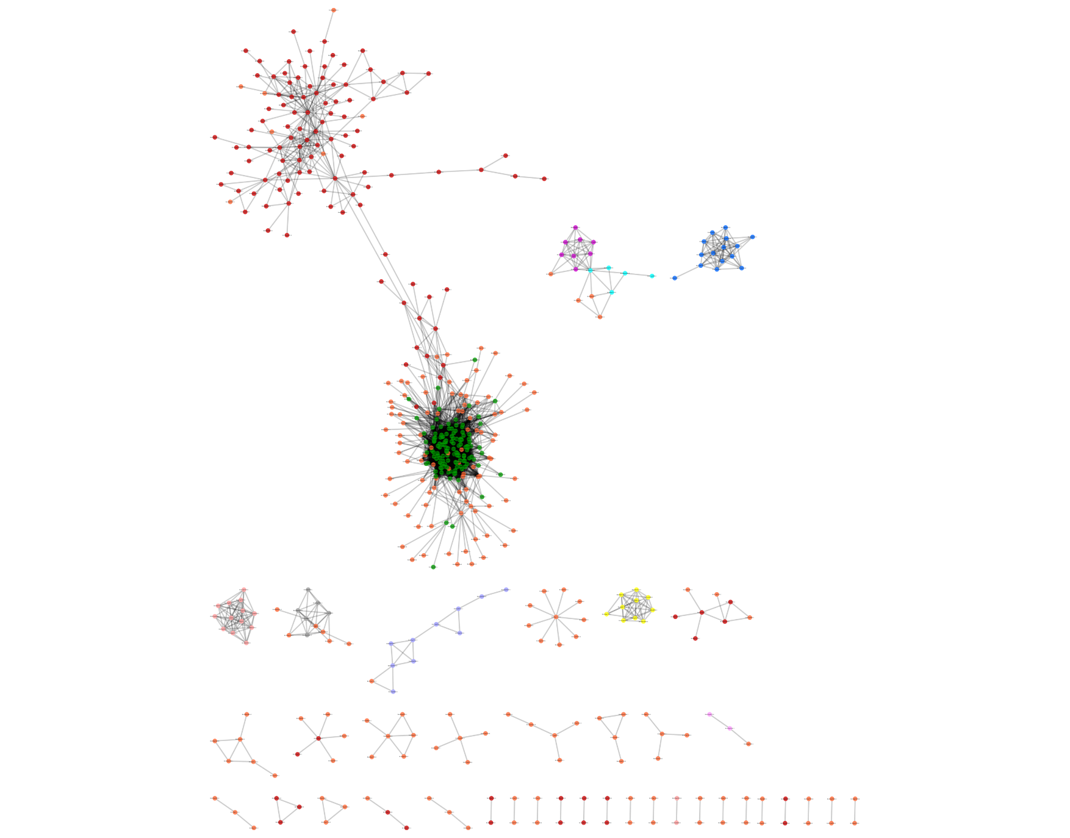
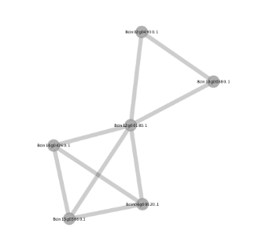

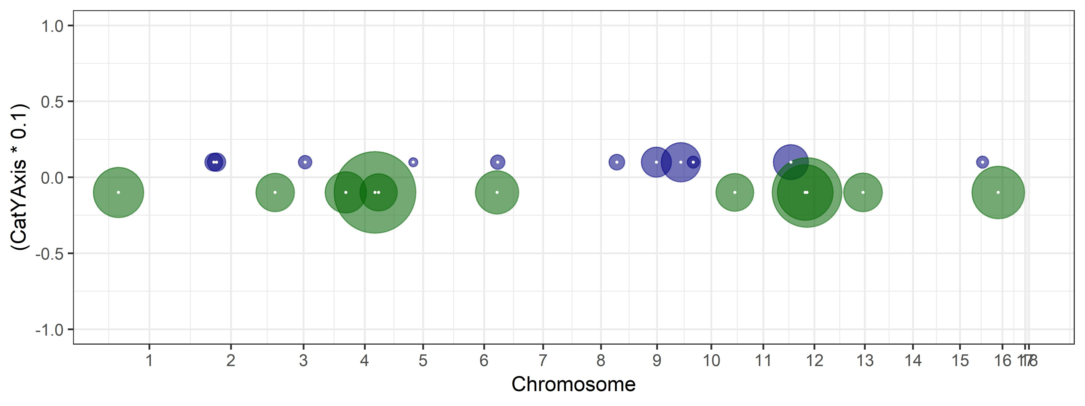
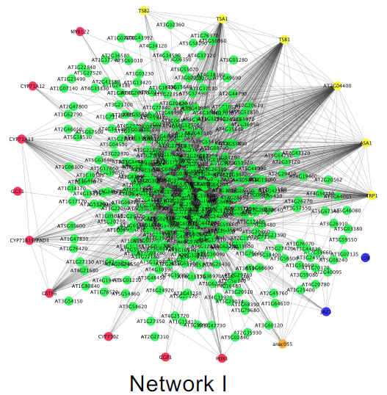
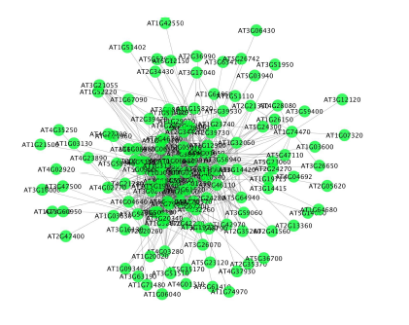
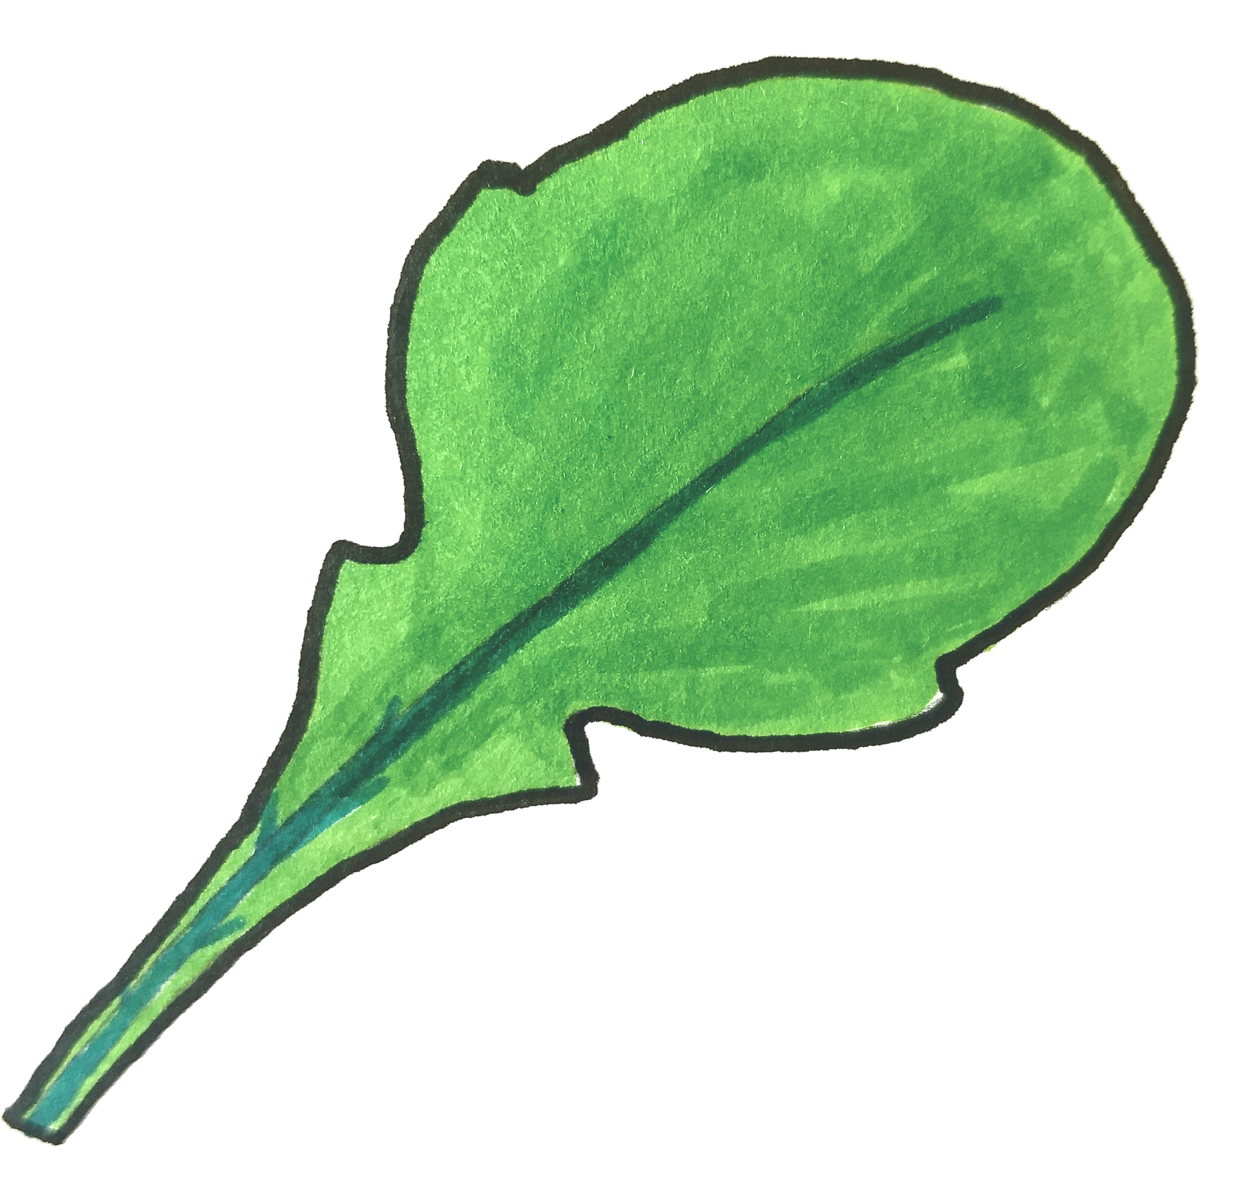
Vesicle/Virulence
Exocytosis Regulation
TSL/Growth
Peptidase
JA/ SA/ Cam
photosynthesis
Figure 6. Genes linked to eQTL hotspots are in virulence and defense co-expression networks. Circles along the B. cinerea genome map are eQTL hotspots, centered at the gene containing the eQTL and with radius proportional to the number of transcripts linked to this hotspot. The gene center is marked with a white dot. Hotspots for B. cinerea transcripts are drawn in blue, hotspots for A. thaliana transcripts are drawn in green. The network names are based on biological functions from gene ontology analysis of network members, from Figure 4 of Zhang et al. 2018 and Figure 6 of Zhang et al. 2017. The A. thaliana networks depicted are the most inclusive of the host-dependent networks, from npr1-1. Links between hotspots and co-expression networks are drawn according to the number of genes shared between them. Variable line weight represents the percent of hotspot target genes shared with the co-expression network; 1-25% is dashed, 25-50% is dotted, 50-75% is solid, 75-100% is heavy solid.

